Slide 1
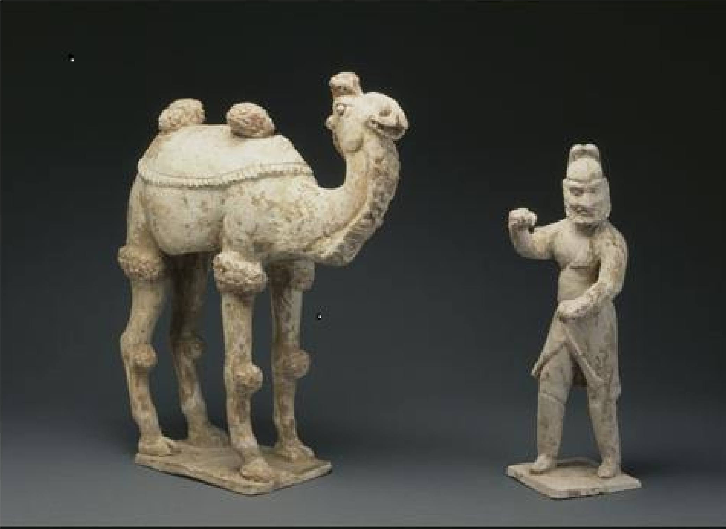

Slide 2
About the Artist…

Slide 3
CONSIDER THE CONTEXT

Slide 6
ART STARTS
Salt dough Recipe:
1 cup salt
1 cup water
2 cups flour

